Slide 1
Amity Institute of Information Technology BCA , Ist Semester Basic Mathematics- Measure of Dispersion Dr Sarika Jain

Slide 2
Measure of Dispersion

Slide 3
Introduction
The central tendency though gives us an idea about the population from which the sample is taken, but it fails to give the more practical description while comparing different samples of different populations. This is more clear from this example:
The scores of marks (out of 40) of students of different sections are given as:
Section A: 7, 10, 12, 13, 15, 20, 21, 27, 30, 35
Section B: 15, 15, 15, 15, 18, 19, 21, 22, 25, 25
Section C: 0, 5, 10, 10, 14, 23, 25, 30, 35, 38
We observe that in each of the above three series there are 10 items and the average marks of students in each section is 19. But there is lot of difference in their formation, i.e. the quality of students in different sections is not same. The marks are spread out differently, i.e. the dispersion is different in each section.

Slide 4
Measures of Dispersion
Range
Quartile Deviation
Mean Deviation
Standard Deviation

Slide 5
Range
The range is the difference between the largest and the smallest observation. Though it is easy to calculate, yet it is not reliable and depends entirely upon extreme values.

Slide 6
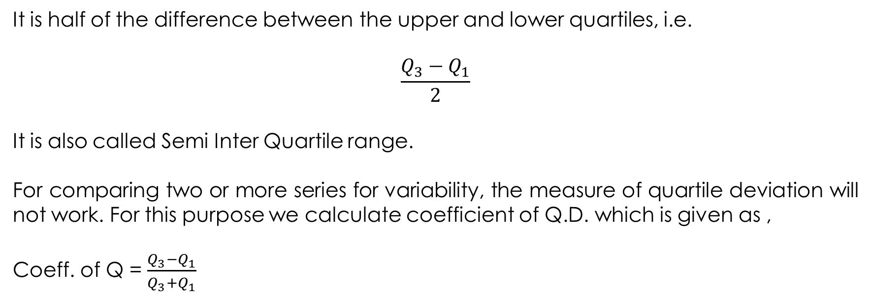
Quartile Deviation
It is half of the difference between the upper and lower quartiles, i.e.
$$\frac{Q_{3}−Q_{1}}{2}$$
It is also called Semi Inter Quartile range.
For comparing two or more series for variability, the measure of quartile deviation will not work. For this purpose we calculate coefficient of Q.D. which is given as ,
Coeff. of Q = $\frac{Q_{3}−Q_{1}}{Q_{3}+Q_{1}}$

Slide 7
Quartile Deviation…..
Example 1. Find the range and Q.D. and its coefficient from the following data:
Class: 10-20 20-30 30-40 40-50 50-60 60-70
Frequency: 3 5 15 10 4 2
Solution: Here the lower limit of smallest class is 10 and higher limit of the highest class is 70.
Therefore range = 70-10 = 60.

Slide 8
Quartile Deviation…..
Calculation of Q.D.
Class | Frequency (f) | C.F.
10-20 | 3 | 3
20-30 | 5 | 8
30-40 | 15 | 23
40-50 | 10 | 33
50-60 | 4 | 37
60-70 | 2 | 39
 | N= 39

Slide 9
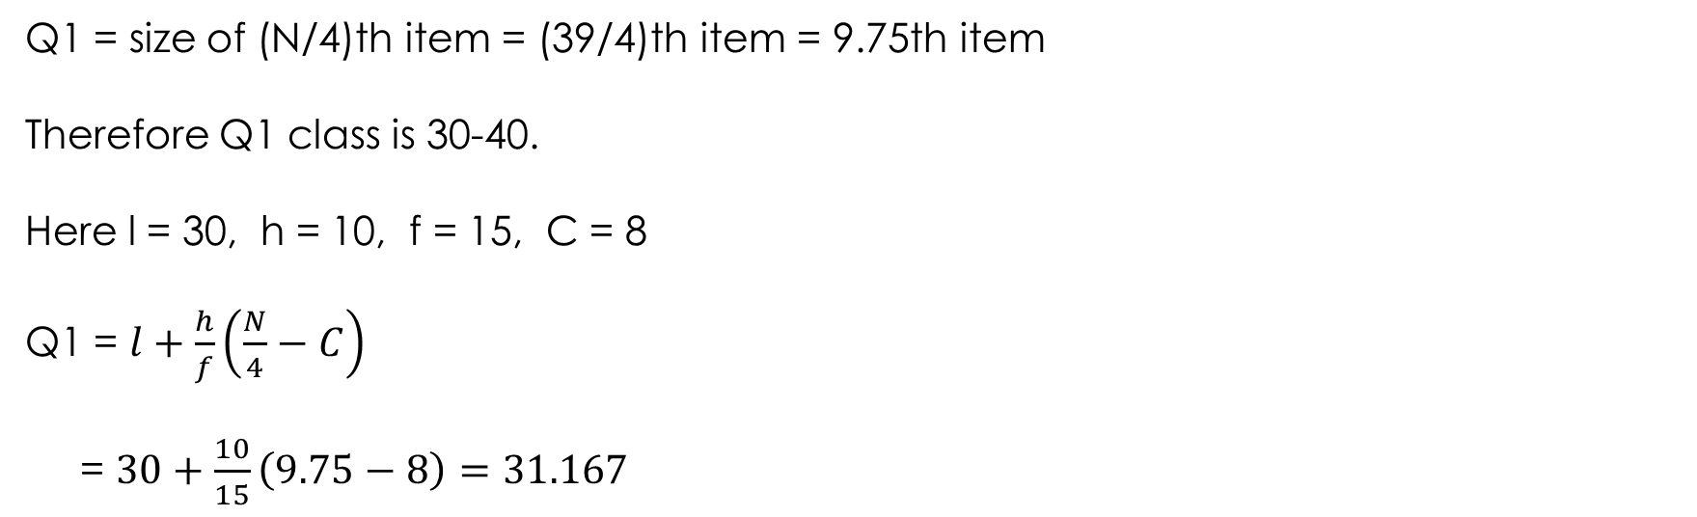
Quartile Deviation…..
Q1 = size of (N/4)th item = (39/4)th item = 9.75th item
Therefore Q1 class is 30-40.
Here l = 30, h = 10, f = 15, C = 8
Q1 = $l+\frac{h}{f}\left(\frac{N}{4}−C\right)$
= $30+\frac{10}{15}\left(9.75−8\right)=31.167$

Slide 10
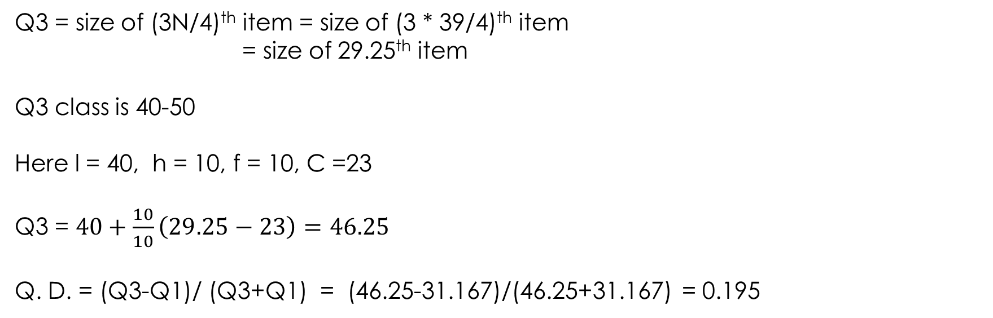
Quartile Deviation…..
Q3 = size of (3N/4)^{th} item = size of (3 * 39/4)^{th} item
= size of 29.25th item
Q3 class is 40-50
Here l = 40, h = 10, f = 10, C =23
Q3 = $40+\frac{10}{10}\left(29.25−23\right)=46.25$
Q. D. = (Q3-Q1)/ (Q3+Q1) = (46.25-31.167)/(46.25+31.167) = 0.195

Slide 11
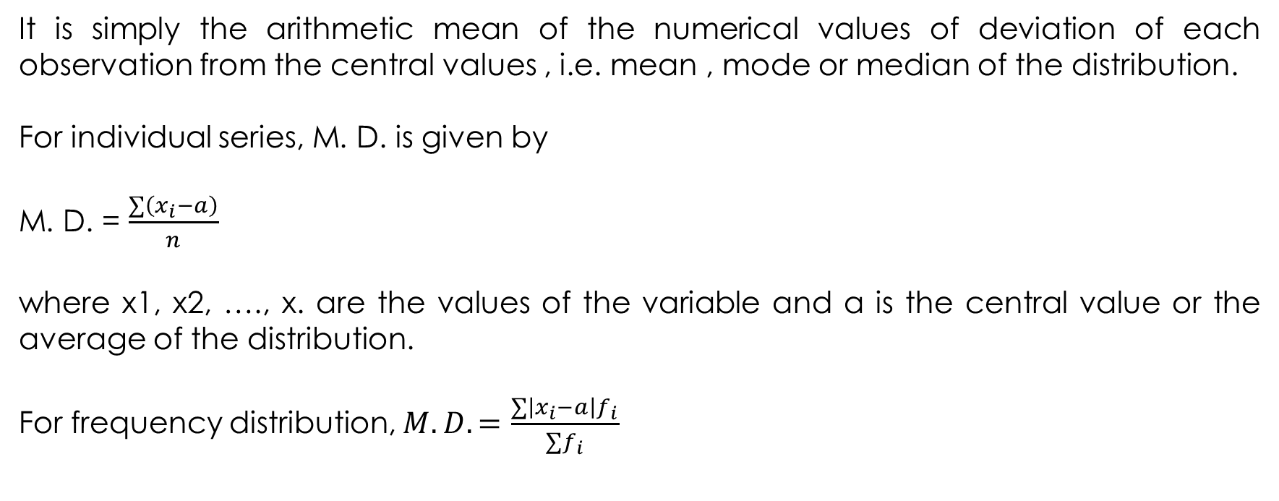
Mean Deviation
It is simply the arithmetic mean of the numerical values of deviation of each observation from the central values , i.e. mean , mode or median of the distribution.
For individual series, M. D. is given by
M. D. = $\frac{∑\left(x_{i}−a\right)}{n}$
where x1, x2, …., x. are the values of the variable and a is the central value or the average of the distribution.
For frequency distribution, $M.D.=\frac{∑\left|x_{i}−a\right|f_{i}}{∑f_{i}}$

Slide 12
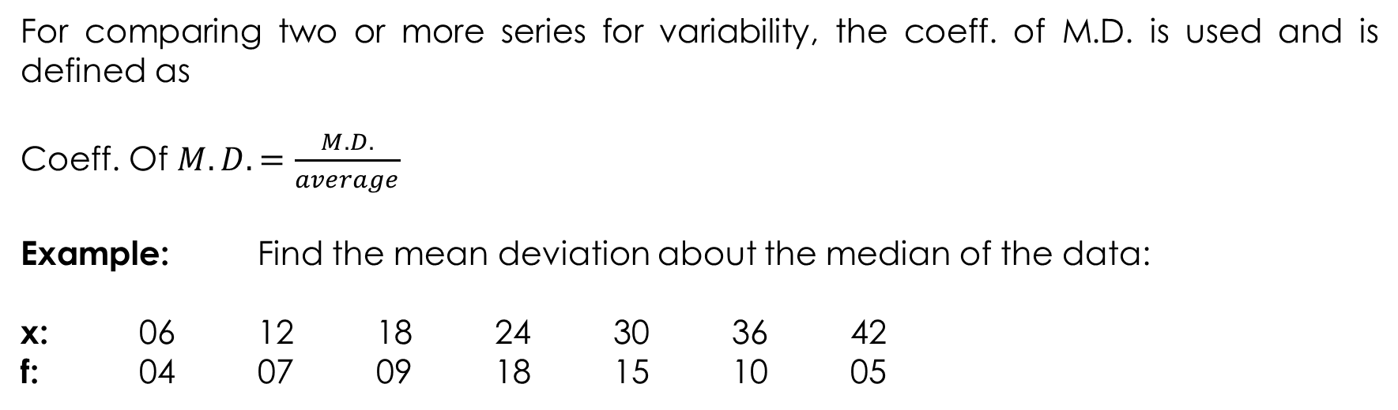
Mean Deviation…..
For comparing two or more series for variability, the coeff. of M.D. is used and is defined as
Coeff. Of $M.D.=\frac{M.D.}{average}$
Example: Find the mean deviation about the median of the data:
x: 06 12 18 24 30 36 42
f: 04 07 09 18 15 10 05

Slide 13
Mean Deviation…..
X | f | c.f.
6 12 18 24 30 36 42 | 4 7 9 18 15 10 5 | 4 11 20 38 53 63 68 | 18 12 6 0 6 12 18 | 72 84 54 0 90 120 90
 | N = 68 |  |  | 510

Slide 14
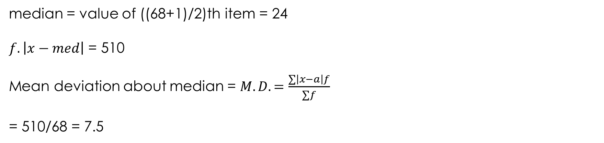
Mean Deviation…..
median = value of ((68+1)/2)th item = 24
$f.\left|x−med\right|$ = 510
Mean deviation about median = $M.D.=\frac{∑\left|x−a\right|f}{∑f}$
= 510/68 = 7.5

Slide 15
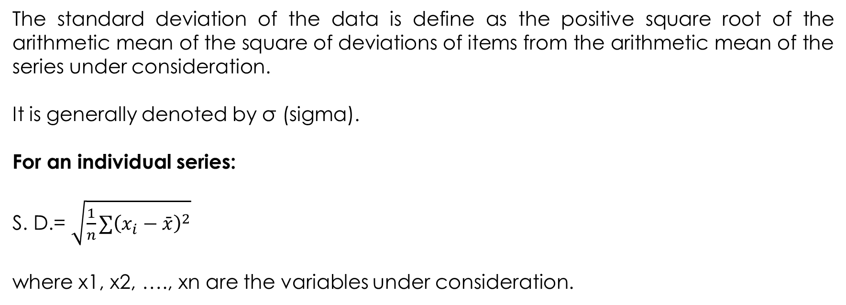
Standard Deviation
The standard deviation of the data is define as the positive square root of the arithmetic mean of the square of deviations of items from the arithmetic mean of the series under consideration.
It is generally denoted by σ (sigma).
For an individual series:
S. D.= $\sqrt{\frac{1}{n}∑{\left(x_{i}−\bar{x}\right)}^{2}}$
where x1, x2, …., xn are the variables under consideration.

Slide 16
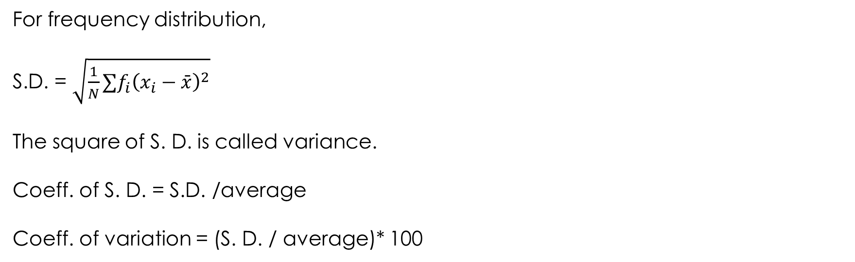
Standard Deviation…..
For frequency distribution,
S.D. = $\sqrt{\frac{1}{N}∑f_{i}{\left(x_{i}−\bar{x}\right)}^{2}}$
The square of S. D. is called variance.
Coeff. of S. D. = S.D. /average
Coeff. of variation = (S. D. / average)* 100

Slide 17
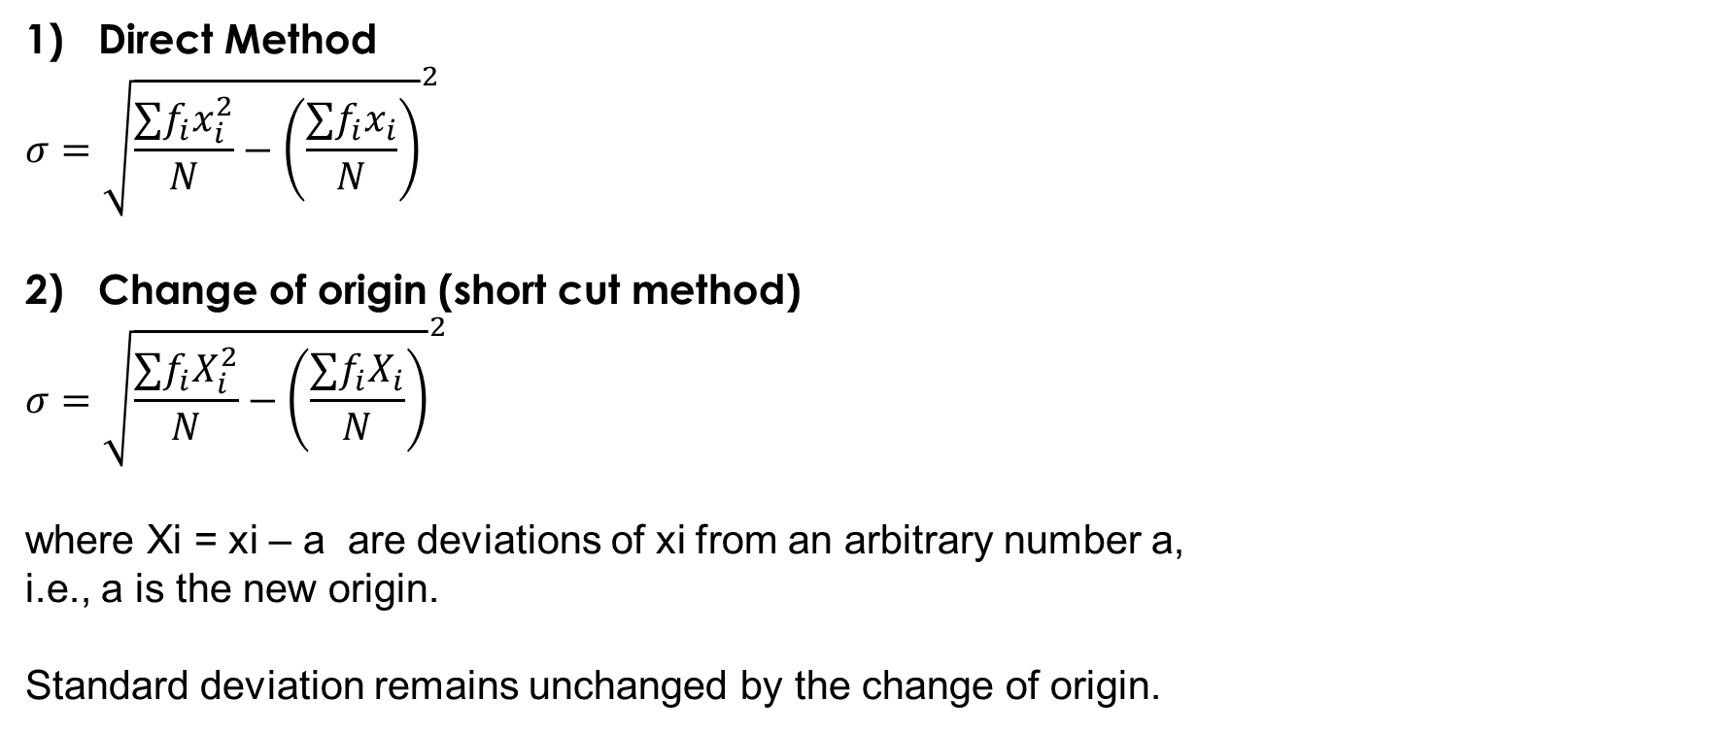
Methods to calculate Standard Deviation
Direct Method
$$σ={\sqrt{\frac{∑f_{i}x_{i}^{2}}{N}−\left(\frac{∑f_{i}x_{i}}{N}\right)}}^{2}$$
Change of origin (short cut method)
$$σ={\sqrt{\frac{∑f_{i}X_{i}^{2}}{N}−\left(\frac{∑f_{i}X_{i}}{N}\right)}}^{2}$$
where Xi = xi – a are deviations of xi from an arbitrary number a,
i.e., a is the new origin.
Standard deviation remains unchanged by the change of origin.

Slide 18
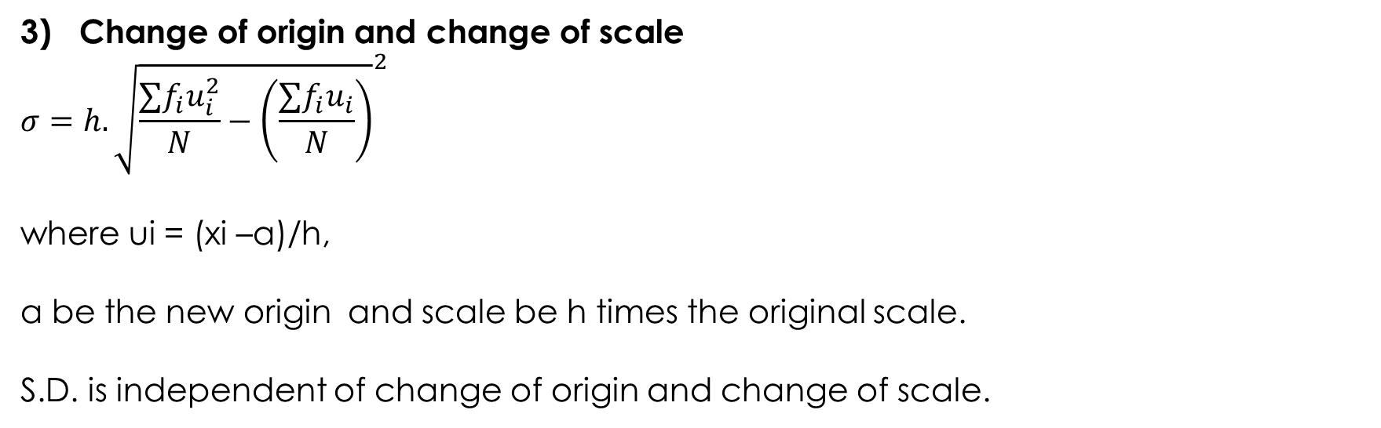
Methods to calculate Standard Deviation.….
Change of origin and change of scale
$$σ=h.{\sqrt{\frac{∑f_{i}u_{i}^{2}}{N}−\left(\frac{∑f_{i}u_{i}}{N}\right)}}^{2}$$
where ui = (xi –a)/h,
a be the new origin and scale be h times the original scale.
S.D. is independent of change of origin and change of scale.

Slide 19
Methods to calculate Standard Deviation.….
Example: Compute the S.D.
x: 1 2 3 4 5 6 7
f: 6 12 18 26 16 10 8
x | f | f.x | (x –avg) | (x –avg)² | f. (x – avg)²
1 2 3 4 5 6 7 | 6 12 18 26 16 10 8 | 6 24 54 104 80 60 56 | -3 -2 -1 0 1 2 3 | 9 4 1 0 1 4 9 | 54 48 18 0 16 40 72
 | 96 | 384 |  |  | 248

Slide 20
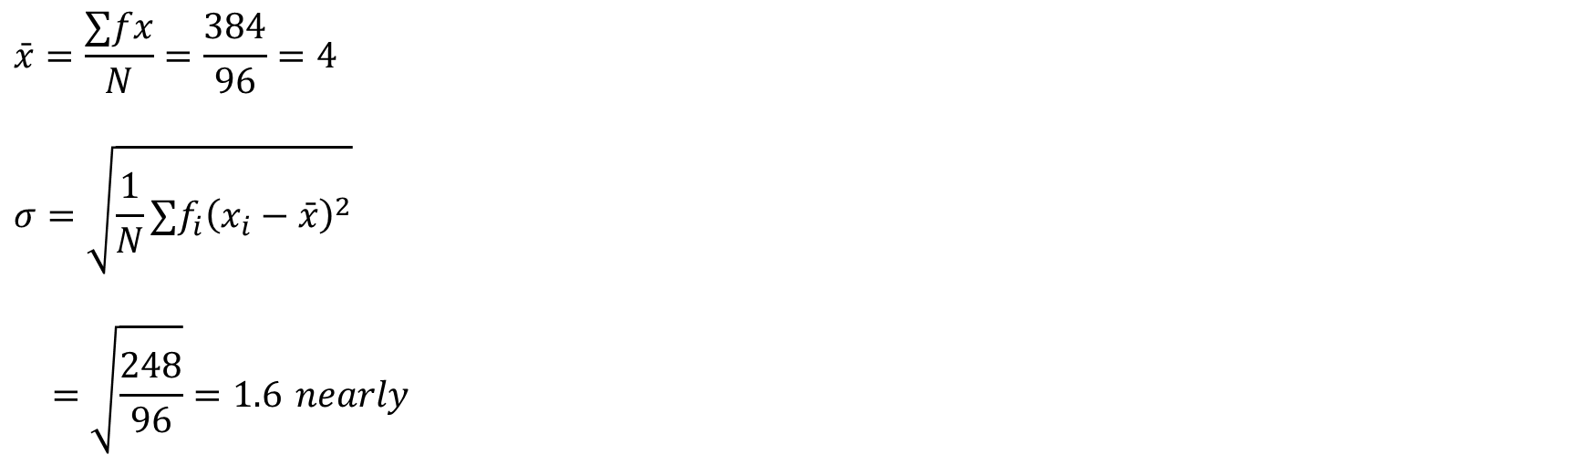
Methods to calculate Standard Deviation.….
$$\bar{x}=\frac{∑fx}{N}=\frac{384}{96}=4$$
$$σ=\sqrt{\frac{1}{N}∑f_{i}{\left(x_{i}−\bar{x}\right)}^{2}}$$
$$=\sqrt{\frac{248}{96}}=1.6 nearly$$

Slide 21
MCQ - 1
Which of the following is not a measure of dispersion?
The range
The 50th percentile
The standard deviation
The interquartile range
The variance
Answer: ii.

Slide 22
MCQ - 2
If the arithmetic mean is multiplied to the coefficient of variation, then resulting value is classified as
Coefficient of deviation
Coefficient of mean
Standard deviation
Variance
Answer: c).

